Slide 1
Responsive web design in Drupal

Slide 2
What is Responsive Web Design?
Responsive Web Design is a strategy for optimizing the display of a web site independent of screen size.
Responsive design uses a blend of fluid layouts, CSS3 media queries and flexible images that when combined allow your site to adapt to the device it's being viewed on.
Your standard desktop site might be three columns, but in your average smartphone you might want to display only one column - this is entirely doable using responsive design - it's a way of re-flowing the content and layout to suit the width of the device.
Fluid grids, flexible images, and media queries are the three technical ingredients for responsive web design

Slide 3
Fluid Grids
Most designers will choose a grid based layout since it’s easier to handle grid based layouts in different kind of devices
Regardless of what the device or screen size is, components in fluid designs are going to flow and adapt to the user environment.
In adaptive grids, we define pixel-based dimensions
In Fluid Grids, we use percentage-based, flexible measurements to keep the proportions of our grid intact as it resizes

Slide 4
Flexible Images
The flexible images, often also called adaptive images. respond to different viewport sizes and display resolutions.
Ways to achieve flexible Images:
Sizing images in relative units (such as em / ex), rather than absolute pixel dimensions.
Set the max-width of the image at 100%
Measure the width of the image as a percentage of the overall width of the page.

Slide 5
Media Queries
Media queries is a process by which code read by the browser detects screen sizes and adjusts layouts to match a particular screen size.
Media queries are cascading style sheet (CSS) code which is able to detect a pre-set screen width and then apply encapsulated code which only runs at that particular size or larger
Below are some of the ways to include Media Queries in css.
<link rel="stylesheet" type="text/css" media="screen and (max-device-width: 480px) and (resolution: 163dpi)" href="shetland.css" />
@media screen and (max-device-width: 480px) {
.column {
float: none;
}
}
@import url("shetland.css") screen and (max-device-width: 480px);

Slide 6
Breakpoint in responsive design
In responsive design, a breakpoint is the “point” at which a website’s content and design will adapt in a certain way in order to provide the best possible user experience.
Essentially, breakpoints are pixel values that a developer/designer can define in CSS. When a responsive website reaches those pixel values, a transformation occurs so that the website offers an optimal user experience.
For developers, a breakpoint is a media query.
For designers, it is the juncture at which a change is made to the way the website content or design appears to the viewer.

Slide 7
Mobile first approach
Mobile First Design means iterating a design with a start from the smallest target device screen size.
Once the smallest screen size display is worked out, you move on to the next major target screen size and adjust your display as necessary to fit the new size

Slide 8
Drupal 8 as a Responsive Website
Drupal 8 has been built with mobile devices in mind.
It has responsive default themes, responsive admin interfaces, and powerful opportunities for mobile-friendly design.
Drupal core comes with two handy modules that are making lots of this responsive behavior possible:
Breakpoint and Responsive Image.
With a basic install only Breakpoint is enabled

Slide 9
Breakpoint module
The Breakpoint module allows you to specify the breakpoints, for example, screen dimensions (minimum or maximum width), at which your website should start showing a different layout.
Breakpoints should be defined in the theme’s themename.breakpoints.yml file
The module manages the height, width, and resolution breakpoints. It enables modules and themes to use each other’s breakpoints.

Slide 10
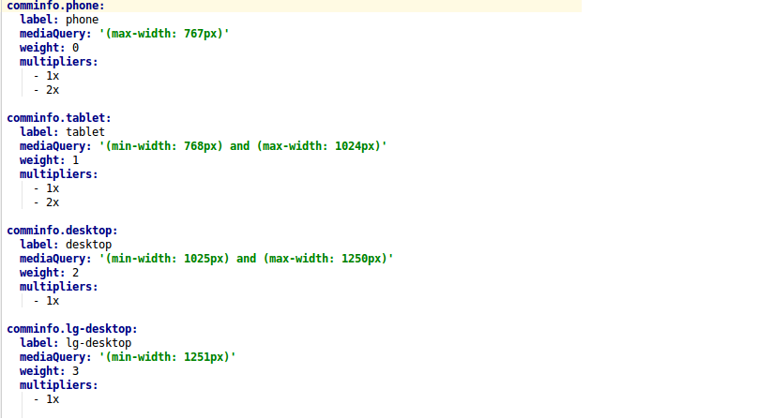
Breakpoint module
label: Is the valid label given for the breakpoint.
mediaQuery: Is the viewport within which the images are rendered.
weight: For the order of display.
multipliers: It's a measure of the viewport's device resolution normally 1x will be used for standard sizes and 2x for retina display.

Slide 11
Responsive Image module
The Responsive Image module provides the appropriate image display for each breakpoint. The module is part of the Drupal 8 core but needs to be enabled.
How to setup and use Responsive Images
create the desired image styles in Configuration — Media — Image Styles
create a “Responsive image style” in Configuration — Media — Responsive Image Styles, choose the theme name in “Breakpoint group,” and assign image styles to breakpoints
assign the responsive image format to the image field of the desired content type in Structure — Content types — *Content type name* — Manage display

Slide 12
Contributed modules for responsive design in Drupal 8 & 9
The Simple Responsive Table is a lightweight module that instantly makes Drupal website tables responsive. All that is needed to do is set the maximum screen width for which tables should be responsive. You can also optionally enable or disable this feature for Drupal admin pages.
The Sidr: Responsive Menus module for Drupal 8 integrates a JavaScript plugin called Sidr, which is great for creating responsive side menus and more. The module should be installed together with the Sidr libraries.

Slide 13
The Juicebox HTML5 Responsive Image Galleries module integrates the famous Juicebox library. The library is known for its full responsiveness, touch gesture support, embedding features etc.
FitVids is a module that handles videos for your fluid layout using it the FitVids.js library.
Mobile Theme is an interesting module that allows you to select a different theme to be served on mobile devices. There are a couple of themes made specifically for mobile phones that you can use for this purpose.

